Slide 1












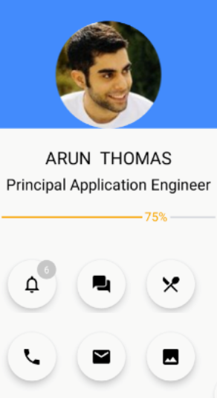
b
Cal
On Boarding Enterprise Mobile APP
Ron Abraham Cherian, Arun Thomas, Akondi Sridevi, Rupesh Reddy Loka, Gabon Williams, Taylor Conners
Under the guidance of Dr. Mohsen Dorochi & in partnership with Continental Corp
Objective
Technologies Used
To build an App, to make On Boarding process easier for a New Hire at Continental. Of the many modules present in App, we have concentrated on “Peer Buddy “ module.
Who is a Peer Buddy?
Peer Buddy is an employee, who is willing to volunteer to assist a current employee or new hire in every aspect ranging from office to personal things.
MongoDB, Database System
Front End
Middleware
How matching is done?
Actions
Matched
Based on
Interests
Location
Department
Job role
New Hire
Current
Employee

